Slide 1
Module3_Part7 Textbook : Operating Systems Concepts by Silberschatz
Operating SYSTEMS

Slide 2
Resource-Allocation Graph
Deadlocks can be described more precisely in terms of a directed graph called a system resource allocation graph.
This graph consists of a set of vertices V and a set of edges E. The set of vertices V is
partitioned into two different types of nodes:
P == { P1, P2, ... , Pn}, the set consisting of
all the active processes in the system,
R == {R1, R2, ... , Rm} the set consisting of all resource types in the system.

Slide 3
Resource-Allocation Graph
A directed edge from process P_{i} to resource type R_{j} is denoted by P_{i} → R_{j;}
it signifies that process P_{i} has requested an instance of resource type Rj and
is currently waiting for that resource.
A directed edge from resource type Rj to process P_{i} is denoted by Rj → P_{i} ; it signifies that
an instance of resource type Rj has been allocated to process P_{i} ;
A directed edge P_{i} -→ R_{j} is called a request edge;
a directed edge Rj → P_{i}; is called an assignment edge

Slide 4
Resource-Allocation Graph
Pictorially we represent each process P_{i} as a circle and each resource type
Rj as a rectangle.
Since resource type Rj may have more than one instance, we represent each such instance
as a dot within the rectangle.
Note that a request edge points to only the rectangle Rj, whereas an assignment edge must
also designate one of the dots in the rectangle.
When process P_{i} requests an instance of resource type Rj, a request edge
is inserted in the resource-allocation graph. When this request can be fulfilled,
the request edge is instantaneously transformed to an assignment edge. When
the process no longer needs access to the resource, it releases the resource; as a
result, the assignment edge is deleted.

Slide 5
Resource-Allocation Graph
Consider the current situation in the system
The sets P, R and E:
P == {P1, P2, P3}
R== {R1, R2, R3, R4}
E == {Pl→ Rl, p2→ R3, Rl→ p2, R2→ p2,R2→ Pl, R3→ P3}
Resource instances:
One instance of resource type R1
Two instances of resource type R2
One instance of resource type R3
Three instances of resource type R4

Slide 6
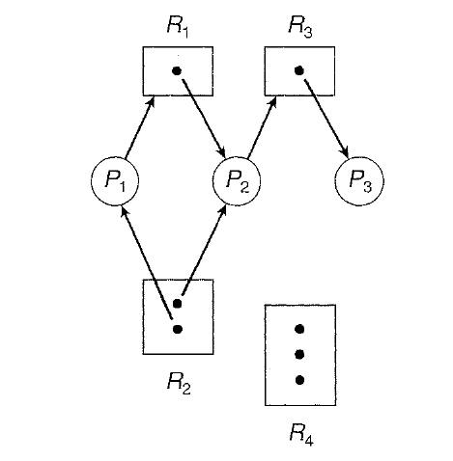
Resource allocation graph
Process states:
Process P1 is holding an instance of resource type R2 and is waiting for an instance of resource type R1 .
Process P2 is holding an instance of R1 and an instance of R2 and is waiting for an instance of R3.
Process P3 is holding an instance of R3 .

Slide 7
Resource allocation graph
Given the definition of a resource-allocation graph, it can be shown that, if the graph contains
no cycles, then no process in the system is deadlocked.
If the graph does contain a cycle, then a deadlock may exist.
If each resource type has exactly one instance, then a cycle implies that a deadlock has occurred.
If the cycle involves only a set of resource types, each of which has only a single instance,
then a deadlock has occurred. Each process involved in the cycle is deadlocked. In this
case, a cycle in the graph is both a necessary and a sufficient condition for the existence
of deadlock.

Slide 8
Resource allocation graph
If each resource type has several instances, then a cycle does not necessarily
imply that a deadlock has occurred. In this case, a cycle in the graph is a
necessary but not a sufficient condition for the existence of deadlock.
To illustrate this concept, we return to the resource-allocation graph
depicted in Figure. Suppose that process P3 requests an instance of resource
type R2. Since no resource instance is currently available, a request edge P3 →
R2 is added to the previous graph. At this point, two minimal cycles exist in
the system:

Slide 9
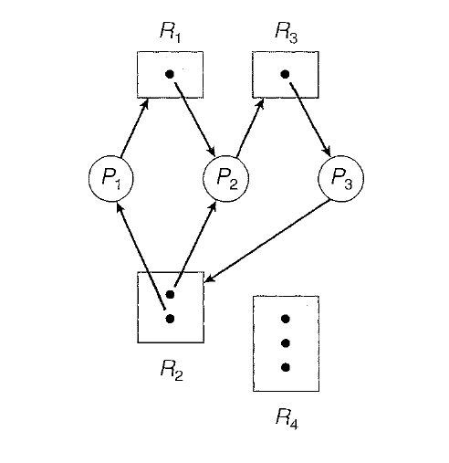
Resource allocation graph
P1 → R 1 → P2 → R3 → P3 → R2 → P1
P2 → R3 → P3 → R2 → P2
Resource-allocation graph with a deadlock

Slide 10
Resource allocation graph
Processes P1, P2, and P3 are deadlocked. Process P2 is waiting for the resource
R3, which is held by process P3. Process P3 is waiting for either process P1 or
process P2 to release resource R2. In addition, process P1 is waiting for process
P2 to release resource R1.

Slide 11
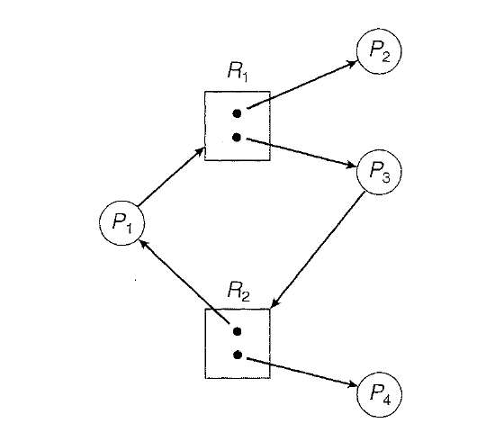
Resource allocation graph
Now consider the resource-allocation graph below. in this example,
we also have a cycle:
P1→ R1→P3→ R2→ P1
Resource allocation graph with cycle and no deadlock
However, there is no deadlock. Observe that process P4 may release its instance
of resource type R2. That resource can then be allocated to P3, breaking the cycle.
In summary, if a resource-allocation graph does not have a cycle, then the
system is not in a deadlocked state. If there is a cycle, then the system may or
may not be in a deadlocked state. This observation is important when we deal
with the deadlock problem.

